Slide 1
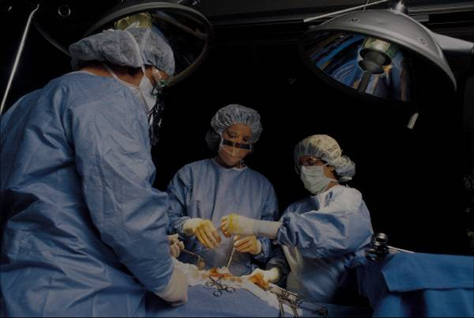
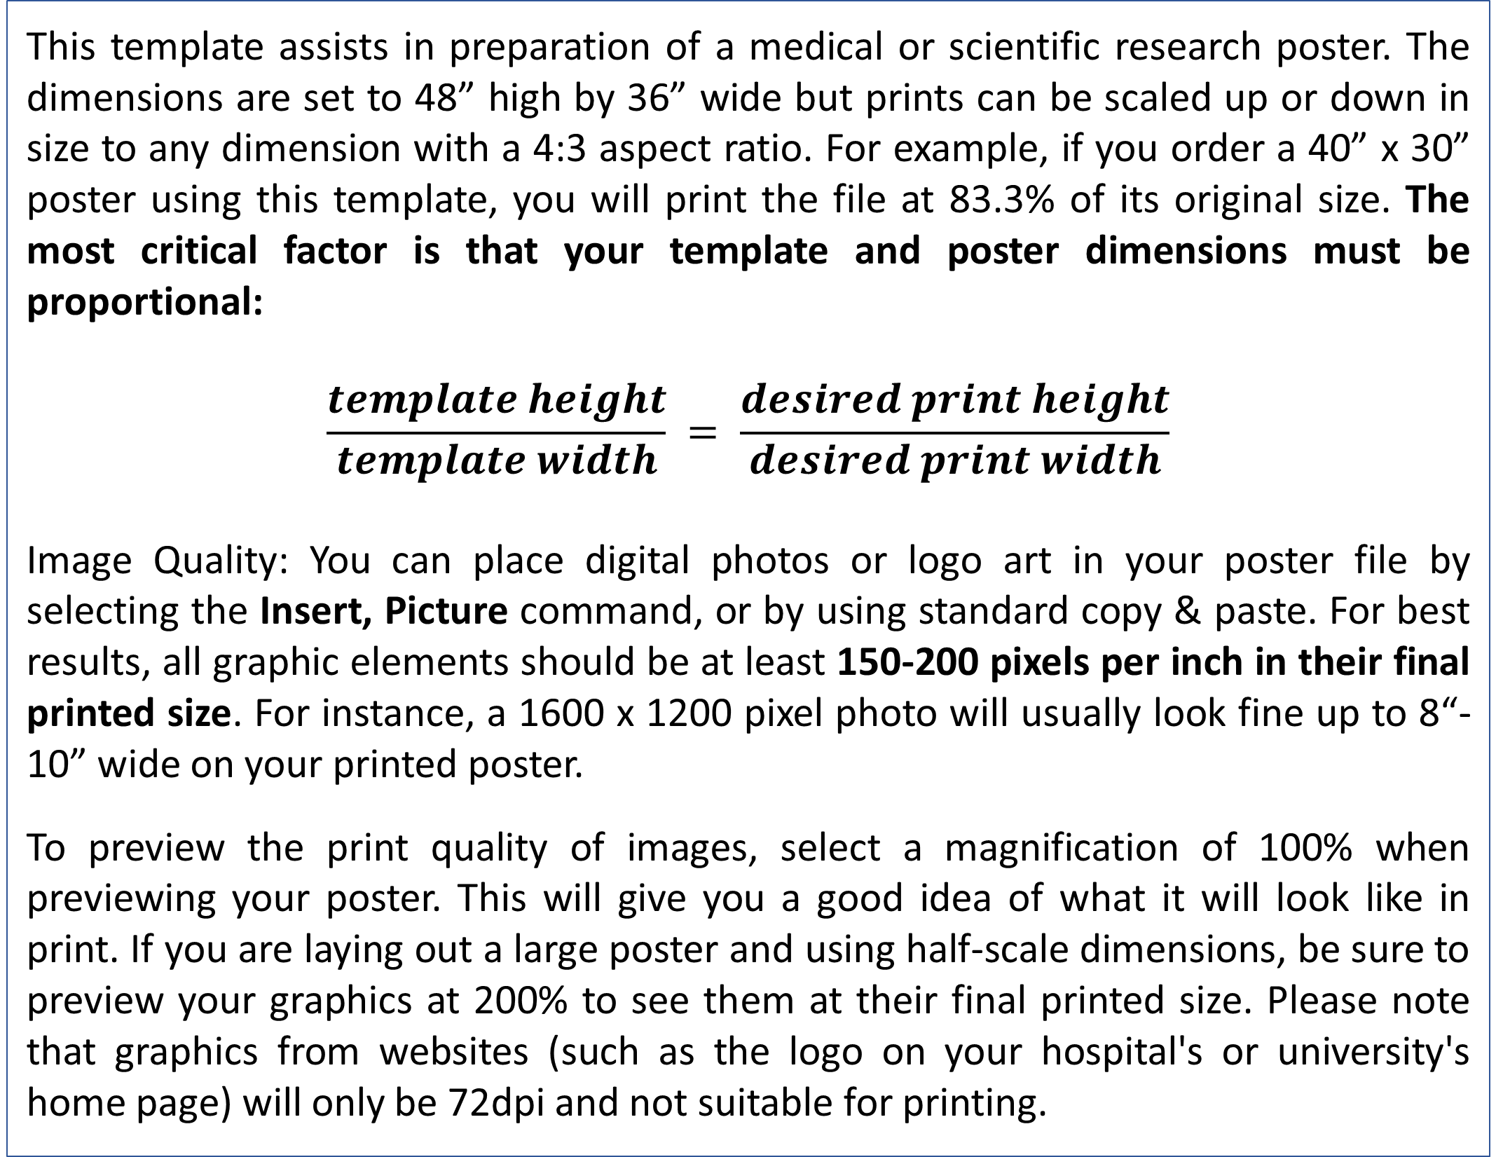
Replace This Text With Your Title
No.XX
John Smith, MD¹; Jane Doe, PhD²; Frederick Jones, MD, PhD^{1,2}
¹University of Affiliation, ²Medical Center of Affiliation
REPLACE THIS BOX WITH
YOUR ORGANIZATION´S
HIGH RESOLUTION LOGO
Abstract
Results
Click here to insert your Abstract text. Type it in or copy and paste from your Word document or other source.
This text box will automatically re-size to your text. To turn off that feature, right click inside this box and go to Format Shape, Text Box, Autofit, and select the “Do Not Autofit” radio button.
To change the font style of this text box: Click on the border once to highlight the entire text box, then select a different font or font size that suits you. This text is Calibri 32pt and is easily read up to 4 feet away on a 48x36 poster.
Zoom out to 100% to preview what this will look like on your printed poster.
Click here to insert your Results text. Type it in or copy and paste from your Word document or other source.
This text box will automatically re-size to your text. To turn off that feature, right click inside this box and go to Format Shape, Text Box, Autofit, and select the “Do Not Autofit” radio button.
To change the font style of this text box: Click on the border once to highlight the entire text box, then select a different font or font size that suits you. This text is Calibri 32pt and is easily read up to 4 feet away on a 48x36 poster.
Zoom out to 100% to preview what this will look like on your printed poster.
Speaking of Results, yours will look better if you remember to run a spell-check on your poster! After you’ve added your content click on Review, Spelling, or press F7.
Introduction
This template assists in preparation of a medical or scientific research poster. The dimensions are set to 48” high by 36” wide but prints can be scaled up or down in size to any dimension with a 4:3 aspect ratio. For example, if you order a 40” x 30” poster using this template, you will print the file at 83.3% of its original size. The most critical factor is that your template and poster dimensions must be proportional:
$$\frac{template height}{template width} = \frac{desired print height}{desired print width}$$
Image Quality: You can place digital photos or logo art in your poster file by selecting the Insert, Picture command, or by using standard copy & paste. For best results, all graphic elements should be at least 150-200 pixels per inch in their final printed size. For instance, a 1600 x 1200 pixel photo will usually look fine up to 8“-10” wide on your printed poster.
To preview the print quality of images, select a magnification of 100% when previewing your poster. This will give you a good idea of what it will look like in print. If you are laying out a large poster and using half-scale dimensions, be sure to preview your graphics at 200% to see them at their final printed size. Please note that graphics from websites (such as the logo on your hospital's or university's home page) will only be 72dpi and not suitable for printing.
Chart 1. Label in 24pt Calibri.
Conclusions
Click here to insert your Conclusions text. Type it in or copy and paste from your Word document or other source.
This text box will automatically re-size to your text. To turn off that feature, right click inside this box and go to Format Shape, Text Box, Autofit, and select the “Do Not Autofit” radio button.
To change the font style of this text box: Click on the border once to highlight the entire text box, then select a different font or font size that suits you. This text is Calibri 32pt and is easily read up to 4 feet away on a 48x36 poster.
Zoom out to 100% to preview what this will look like on your printed poster.
Table 1. Label in 24pt Calibri.
 | Heading | Heading | Heading
Item | 800 | 790 | 4001
Item | 356 | 856 | 290
Item | 228 | 134 | 238
Methods and Materials
Click here to insert your Methods and Materials text. Type it in or copy and paste from your Word document or other source.
This text box will automatically re-size to your text. To turn off that feature, right click inside this box and go to Format Shape, Text Box, Autofit, and select the “Do Not Autofit” radio button.
To change the font style of this text box: Click on the border once to highlight the entire text box, then select a different font or font size that suits you. This text is Calibri 32pt and is easily read up to 4 feet away on a 48x36 poster.
Zoom out to 100% to preview what this will look like on your printed poster.
Figure 1. Label in 20pt Calibri.
Figure 2. Label in 20pt Calibri.
Figure 3. Label in 20pt Calibri.
Acknowledgements
Click here to insert your Acknowledgements text. Type it in or copy and paste from your Word document or other source.
This text box will automatically re-size to your text. To turn off that feature, right click inside this box and go to Format Shape, Text Box, Autofit, and select the “Do Not Autofit” radio button.
Contact
References
<your name>
<your organization>
Email:
Website:
Phone:

